Slide 1

GLOBAL TERRORISM
Capstone Project by ANN
HDSC Winter Cohort ’22
Date: 30th April, 2022
Who and where?

Slide 2
Today’s presenters
Shubhangi Sanyal
[Data Science Track]
Innocent Akpareva
[Data Science Track]

Slide 3
Problem Statements
Defense against terrorism is difficult because of terrorism's surprise advantage, since we do not know the type, extent, timing or precise location of the next attack. Preventive measures are still the best defense against terrorism. It would be a great advantage to know which region might be the target of an attack. This knowledge could save countless lives. To this end, we have decided to give our project the following missions:
Prediction of a successful attack
Prediction of target region of an attack
Notes:
Terrorism is a persistent global threat that knows no border, nationality or religion and it is a challenge that the international community must tackle together.

Slide 4
OUR APPROACH
For problem statement 1 – predicting a successful attack:
A deep learning model (Sequential) has been developed to predict whether an attack will be successful or not. It uses supervised learning to learn the different features responsible for the success of an attack and uses those concepts to predict the success rate for future attacks.
For problem statement 2 – predicting the target region of a terrorist attack:
Several machine learning ensemble models like Logistic Regression, Random Forest, KNN, etc., have been tested against the dataset to determine the target region of an attack.

Slide 5
Dataset Description
Source:
https://www.kaggle.com/datasets/START-UMD/gtd
The Global Terrorism Database (GTD) is an open-source database including information on terrorist attacks around the world from 1970 through 2017. The GTD includes systematic data on domestic as well as international terrorist incidents that have occurred during this period and now includes more than 180,000 attacks. The database is maintained by researchers at the National Consortium for the Study of Terrorism and Responses to Terrorism (START), headquartered at the University of Maryland.
This dataset consists of 181691 rows and 135 columns containing information about various terrorist attacks across the world over a while of 1970 to 2017, except 1993. The large number of columns includes information about location, tactics, perpetrators, targets, and outcomes.

Slide 6
Workflow
Feature Engineering
Deep Learning modelling
Exploratory Data Analysis
Machine Learning modelling
Model
deployment

Slide 7
Data Wrangling
Missing values and redundant features were dropped. After the initial data cleaning, 27 columns were chosen out of 135 which were then further scaled down to fit the specific purposes of the problem definitions.
Duplicate rows were dropped.
The missing values for the numerical features were replaced with the median of that respective column, and the same for string features was replaced with ‘Unknown’.

Slide 8
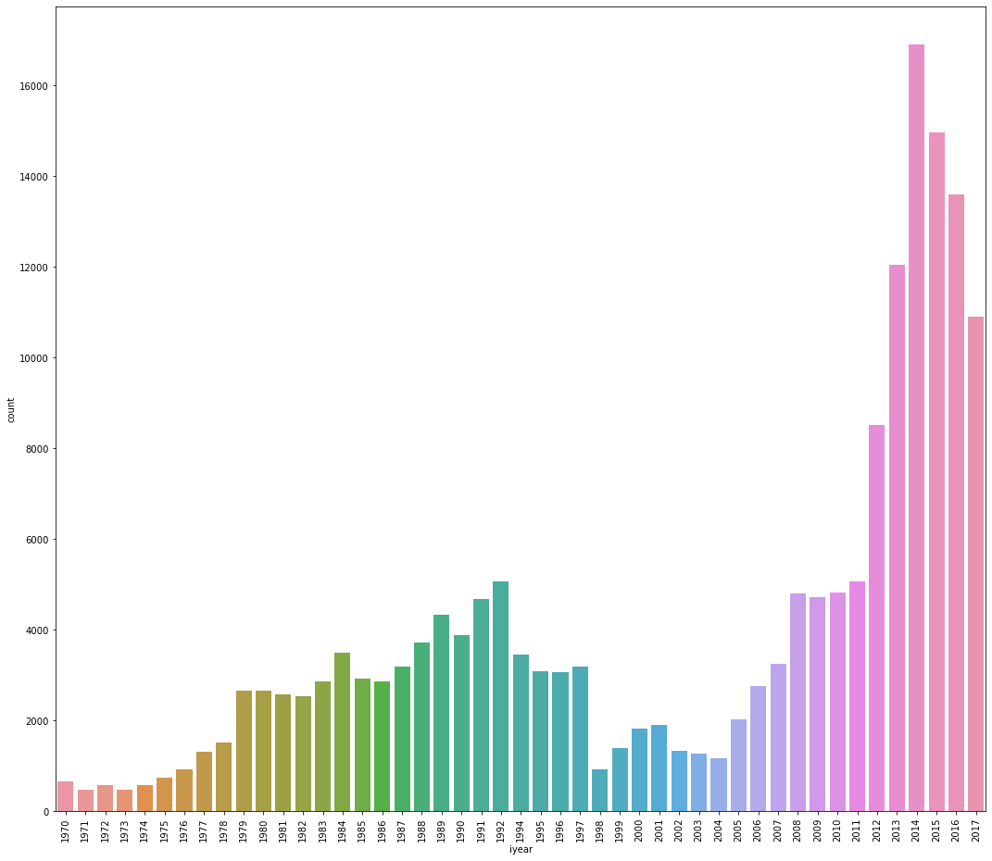
Data Visualization
Global terrorism rate over the years:
2014
The rate of global terrorism increased over time with 2014 recording the highest rate of global terrorism while 1971 with the least recorded terrorist attacks.
Total crime
1971
1970 – 2017

Slide 9
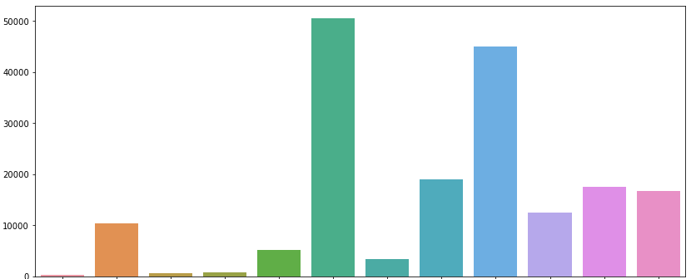
Data Visualization
Terrorist attacks vs. region
Middle East & North Africa
South Asia
Total terrorist attacks
Australasia & Oceania
Region
Notes:
The regions with the most occurrences of global terrorism are the Middle East & North Africa, and South Asia while Australasia and Oceania is the region with the least number of attacks.

Slide 10
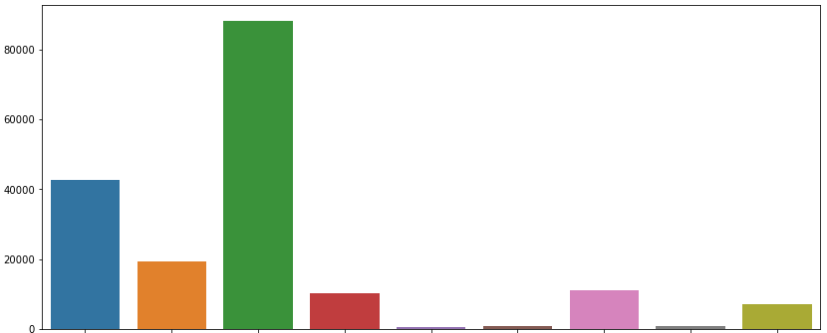
Data visualization
Terrorist attack types and their significance:
Armed Assault
Hostage Taking (Kidnapping)
Total terrorist attacks
Bombing/Explosion
Hostage Taking (Barricade Incident)
Assassination
Infrastructure attack
Unknown
Hijacking
Unarmed assault
Attack type
Notes:
The predominant form of attack in global terrorism has been carried out by the use of Bombing/Explosion followed by Armed Assault, while Hijacking has been the least form used.

Slide 11
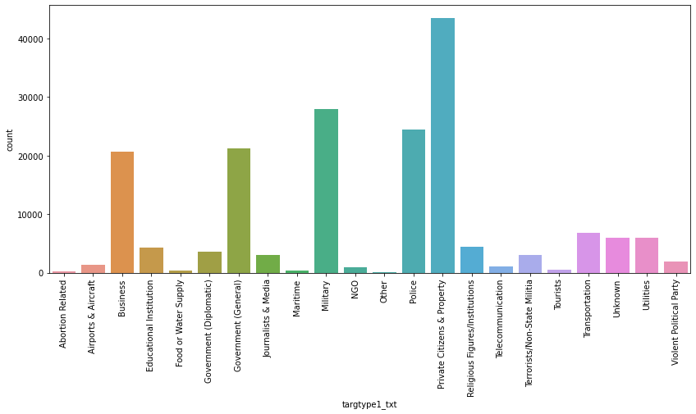
Data visualization
Terrorist Attacks and their targets:
Notes:
The most targeted area of global terrorism has been Private Citizens & Property followed by the Military and the Police.

Slide 12


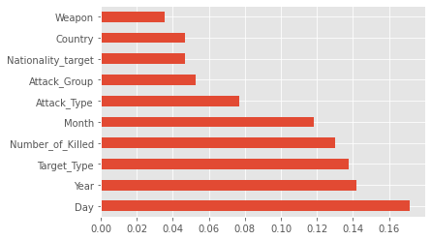


Feature Engineering
Date features (such as year, month, day) were merged into a date column with
a uniform
format.
Imbalance in the dataset was tackled by oversampling
the minority
category.
‘Extratrees’ classifier
was used to discern the important features in the dataset.
Label
Encoder
was used on categorical features.

Slide 13
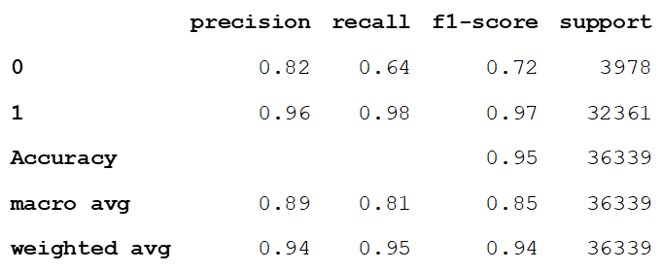
Deep learning modelling
In order to predict whether a terrorist attack is going to be successful or not, a deep learning model - Sequential, was developed.
This model was fine-tuned with the ‘adam’ optimizer and ‘Binary cross-entropy’ loss function, resulting in the following classification report.
From the above classification report, it can be observed that the deep learning model performed fairly well on the dataset by achieving an 89% accuracy. The slight discrepancies in the precision for both the classes (successful and unsuccessful attacks) arose because of oversampling of the minority class i.e., unsuccessful attacks.

Slide 14
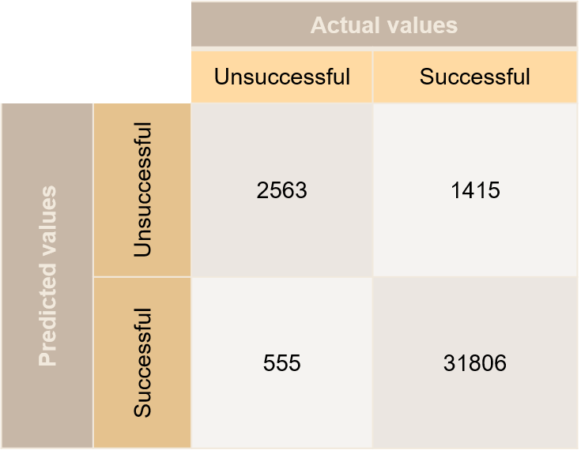
Confusion matrix – Sequential deep learning

Slide 15
Machine Learning modelling
Model | Accuracy | Precision | Recall | F1-score
Logistic Regression | 0.63 | 0.86 | 0.63 | 0.696
Decision Tree Classifier | 0.92 | 0.93 | 0.92 | 0.924
SVC | 0.85 | 0.91 | 0.85 | 0.868
Gradient Boosting Classifier | 0.90 | 0.93 | 0.90 | 0.912
Random Forest Classifier | 0.93 | 0.94 | 0.93 | 0.935
For predicting the target region of attack, several ensemble machine learning models have been used with the following performance metrics.
Based on this, it was observed that Random Forest modelling provided the most accurate results when compared to the other models.

Slide 16
Random Forest confusion matrix:
 |  | Actual Values
 |  | Positive | Negative
Predicted values | Positive | 4762 | 1359
 | Negative | 2309 | 46078

Slide 17
Summary
Data visualizations helped in extracting useful information like the rate of global terrorism over the years, regions targeted and weapons used.
Using deep learning model, predictions of successful attacks were achieved with 89% accuracy.
From various ensemble machine learning models, Random forest provided the most accurate prediction of target region of an attack.
Some of the main challenges faced during this project were tackling a huge dataset which made feature extraction tricky, and the class imbalance which, even though was tackled by oversampling, resulted in slightly biased results.
An obvious improvement on the problem statements would be to collect more raw data on unsuccessful attacks so as to reduce the class imbalance problems.
Further, the implementation of more deep learning models can produce better and more accurate results.

Slide 18
Thank You
We will end our presentation with model deployment
Created and presented by: Team ANN

